Slide 1
The U.S. Constitution
Content Statement 5: As the supreme law of the land, the U.S. Constitution incorporates basic principles which help define the government of the United States as a federal republic including its structure, powers and relationship with the governed.

Slide 2
National Archives in Washington D.C.

Slide 3
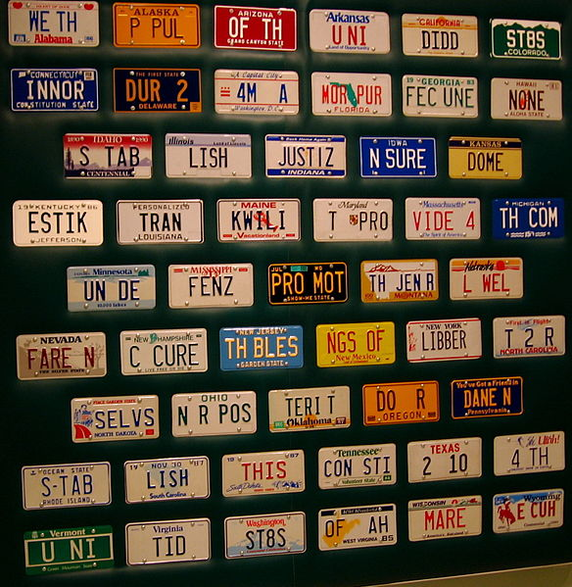
The Preamble
We the People of the United States, in Order to form a more perfect Union, establish Justice, insure domestic tranquility, provide for the common defence, promote the general Welfare, and secure the Blessings of Liberty to ourselves and our Posterity, do ordain and establish this Constitution for the United States of America.

Slide 4
The Preamble (cont)
Constitution was written in 1787 and ratified in 1788
Longest surviving written charter of government
WE THE PEOPLE
Government is limited

Slide 5
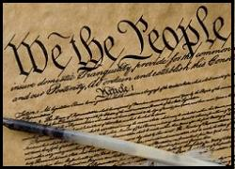
The Preamble (cont)
The Preamble explains the purposes of the Constitution, and defines the powers of the new government as originating from the people of the United States
Preamble Video

Slide 6
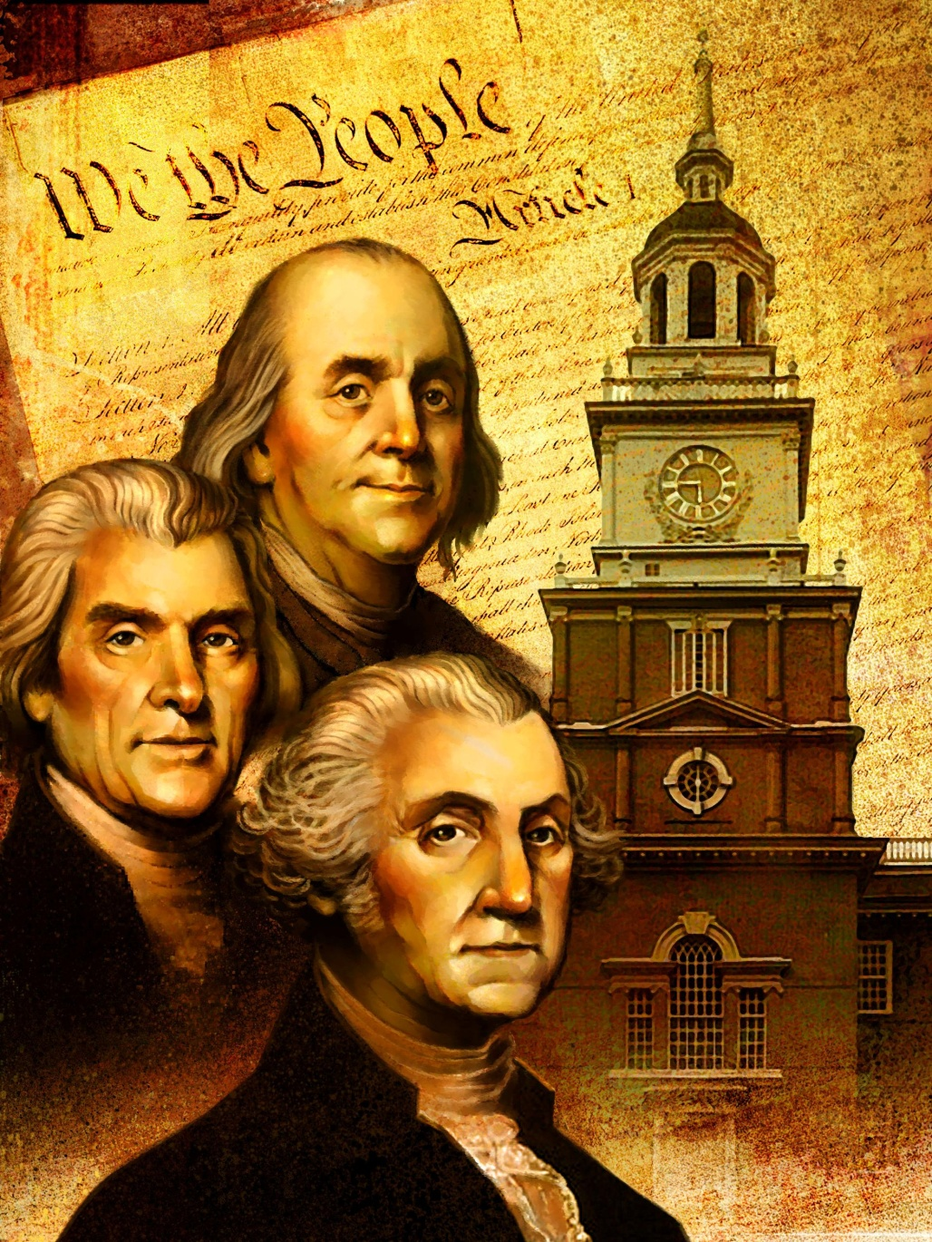
The Constitution
Popular Sovereignty
Limited Government
Federalism
Separation of Powers
Checks and Balances

Slide 7
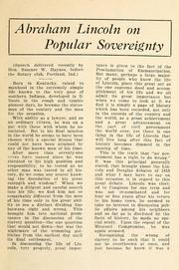
Popular Sovereignty
Government authority is derived FROM the people
The government is not run by kings, legislature, or courts
Government governs with the consent of people
Ruled by the PEOPLE

Slide 8
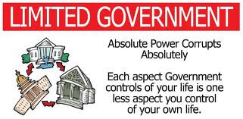
Limited Government
Term is NOT found in the Constitution
Government can only exercise powers granted to it
Government must be enacted according to the rule of the law
The government of the United States, those three words declare, only exists because We the People choose that it should exist
Builds upon idea of popular sovereignty

Slide 9
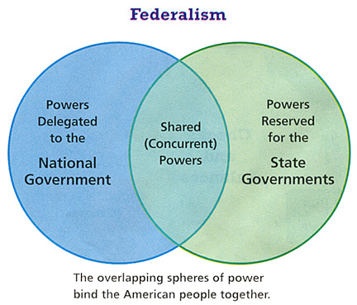
Federalism
System of government in which power is divided between a central authority and constituent units
Reflected in division of powers between the national government and the states
Has meant different things over different periods of time
Division of power between states and national government

Slide 10
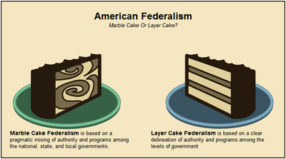
Federalism

Slide 11
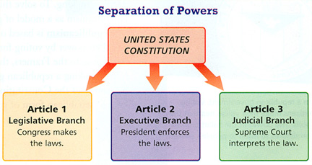
Separation of Powers
Requires a distribution of governmental powers among independent branches
Each branch has specific field of authority and unique set of responsibilities within the operation of the government
Article I
Article II
Article III
Three ring circus

Slide 12
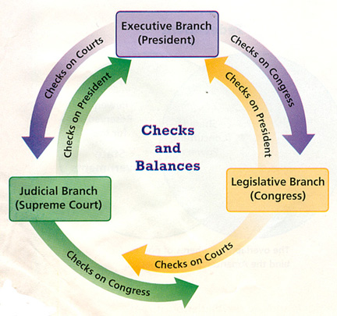
Checks and Balances
A system for controlling government power
Branches of government possess the ability to retrain certain actions of the other branches
Game

Slide 13
Article 1
Legislative
Congress has power to make laws
Controls the money
Declare war
Congress shall be bicameral
House of Representatives:
Elected every two years
Choose their own leaders
Power of Impeachment
Senate
Elected every 6 years
Vice President is President of Senate (no vote)
Hear impeachment trials

Slide 14
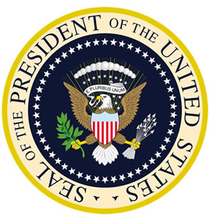
Article 2
President is elected for four years, along with Vice President
Electoral College (Ohio has 18)
Commander in Chief
State of the Union
Impeachment

Slide 15
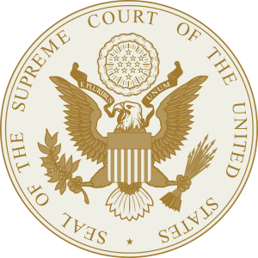
Article 3
Establish Supreme Court
Which cases Supreme Court hears
Treason/Ambassadors
Here cases that cross state lines
Cases that violate federal law

Slide 16
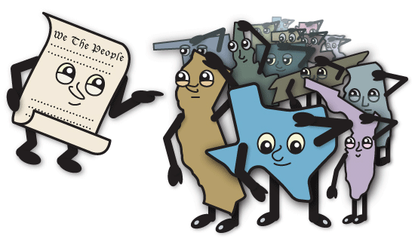
Article 4: The States
Each State to honor all others
This explains that each state has their own right to function as an individual state without infringement from other states.
Citizens from each state will be treated fairly in all other states
Citizens who commit crimes and are found in other states will be transported to the state in which the crime was committed
Congress has the power to make rules and regulations for new states
Only Congress has the authority to admit new states

Slide 17
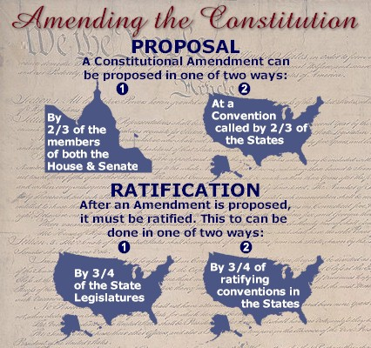
Article 5: Amendments
How amendments are ratified
Process is left completely to the states
President has no official say in ratifying an amendment
Process of ratifying amendments
Pass two thirds of BOTH houses
Two-thirds majority
Informal changes – a change that takes place without anything being actually changed formally
i.e. Political Parties, voting originally for land owner
Judicial interpretation – marital jurisdiction before Privacy Cases
Popular Amendment – never been used

Slide 18
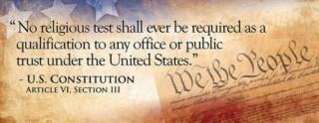
Article 6: Debts, Supremacy, Oaths
All debts incurred against the United States will be valid
The Constitution is established as the Supreme Law of the Land

Slide 19
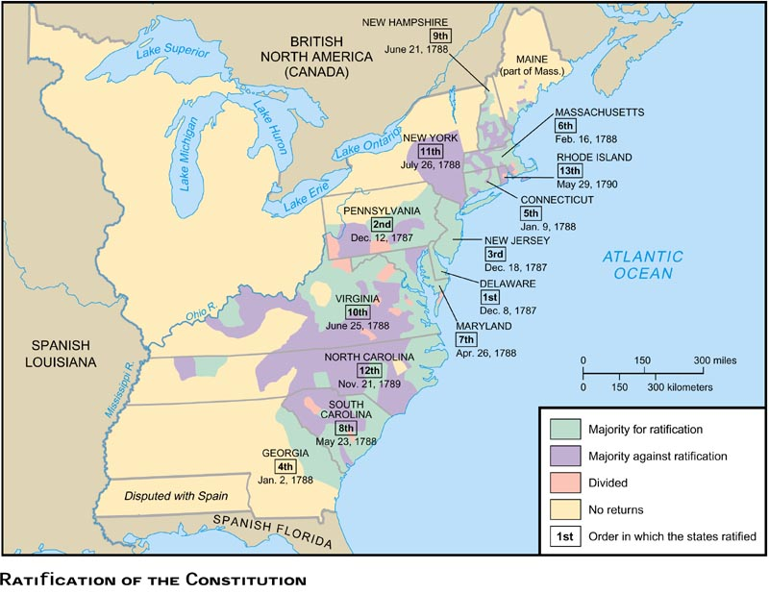
Article 7: Ratification
Nine of the thirteen states are needed to ratify the constitution
All states but Rhode Island ratified the Constitution

Slide 20
Structure and Functions of the Federal Government
Topic: Three branches compose the basic structure of the federal government. Public policy is created through the making of laws, the execution of the laws and the adjudication of disputes under the laws.

Slide 21
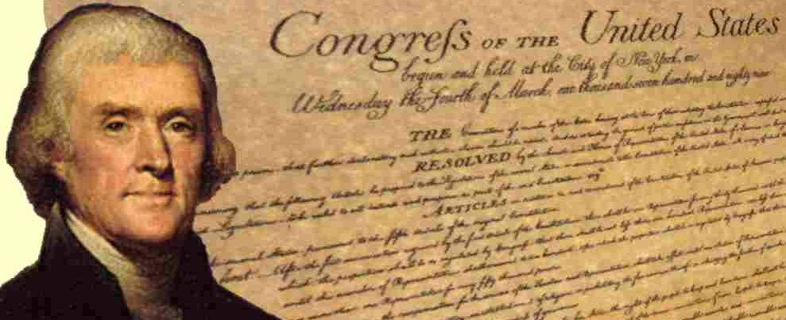
The U.S. Constitution
Content Statement 14:
Law and public policy are created and implemented by three branches of government; each functions with its own set of powers and responsibilities.

Slide 22
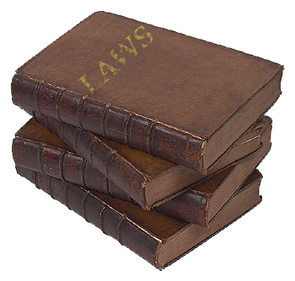
Laws and Public Policy
Laws are rules recognized as binding and enforced by a government.
Public policy consists of institutional actions and procedures pursued by a government in carrying out its functions.

Slide 23
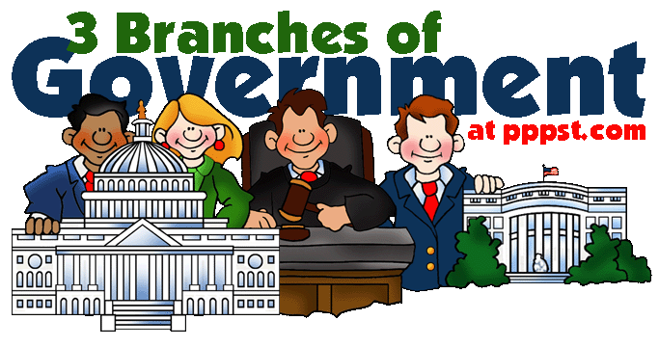
Responsibilities of the 3 branches:
The U.S. Constitution establishes roles for each of the three branches of government related to law and public policy.
It assigns each branch special powers and responsibilities.

Slide 24
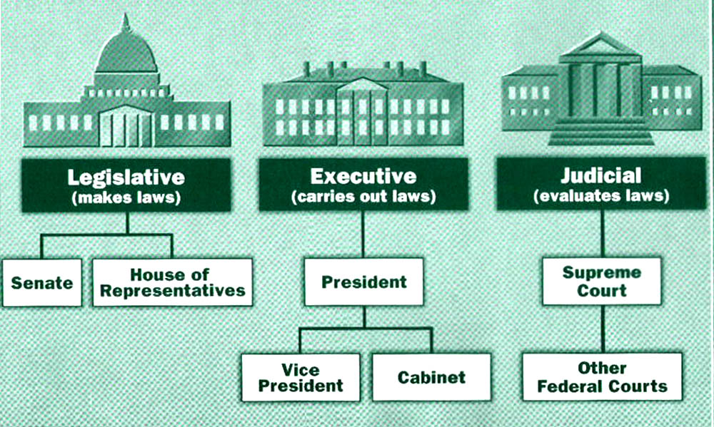
Responsibilities (cont.):
Laws are made by the legislative branch.
Laws are enforced by the executive branch.
Laws are interpreted by the judicial branch as it resolves disputes under the laws.
The actions and procedures of all three branches establish public policy.

Slide 25
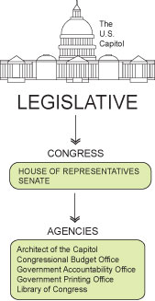
Legislative Branch
conducting oversight investigations
responsibility to oversee everything run by the President
instituting impeachment proceedings
to charge with a crime or misdemeanor; specifically : to charge (a public official) before a competent tribunal with misconduct in office
ratifying treaties
passing resolutions

Slide 26
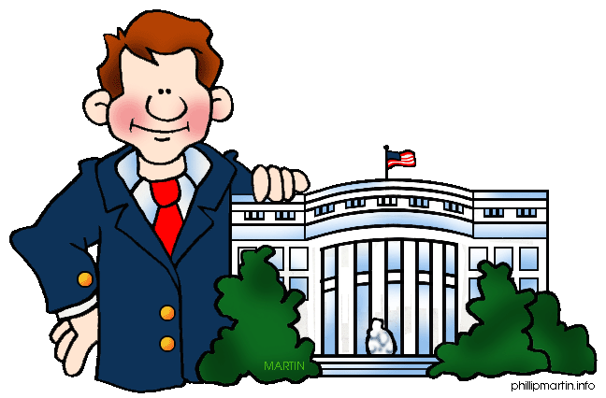
Executive Branch
making rules and regulations
proposing the federal budget
recognizing foreign nations
issuing executive orders
official documents, numbered consecutively, through which the President of the United States manages the operations of the Federal Government

Slide 27
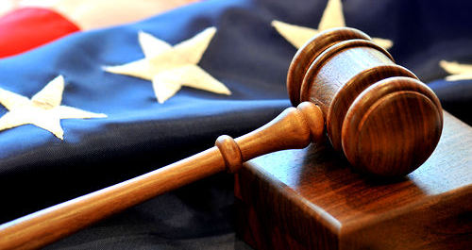
Judicial Branch
issuing writs of certiorari
an order a higher court issues in order to review the decision and proceedings in a lower court and determine whether there were any irregularities
establishing judicial procedures
sentencing offenders
accepting amicus curiae briefs
one (as a professional person or organization) that is not a party to a particular litigation but that is permitted by the court to advise it in respect to some matter of law that directly affects the case in question

Slide 28
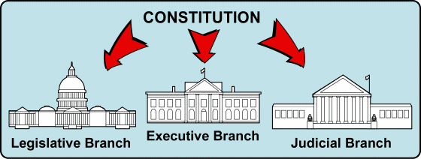
The U.S. Constitution
Content Statement 15:
The political process creates a dynamic interaction among the three branches of government in addressing current issues
.

Slide 29
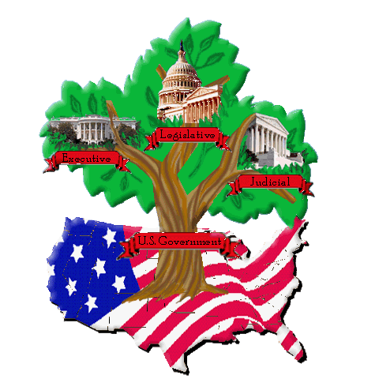
Public Policy & the 3 Branches
Current issues are addressed by all three branches of the government as they make public policy.
Interactions among the branches range from instances where they work in concert (together) to instances involving the exercise of checks and balances.
In this context, the political process becomes one of the branches exercising their powers to influence public policy.
The U.S. Constitution addresses the interaction among the branches of government with a system of checks and balances.

Slide 30
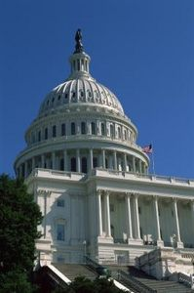
Legislative “checks”
Legislative on executive – veto override, impeachment of civil officers, Senate approval of appointments and treaties, raise and govern military forces
Legislative on judicial – creation of lower courts, determination of appellate jurisdiction of the Supreme Court, impeachment of judges

Slide 31
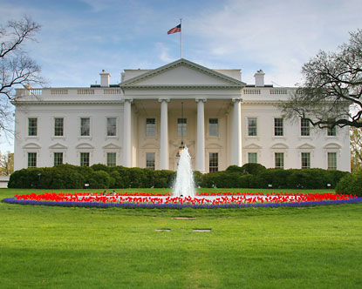
Executive “checks”
Executive on legislative – convene either or both houses of Congress, veto legislation;
Executive on judicial – appoint judges, issue pardons and reprieves

Slide 32
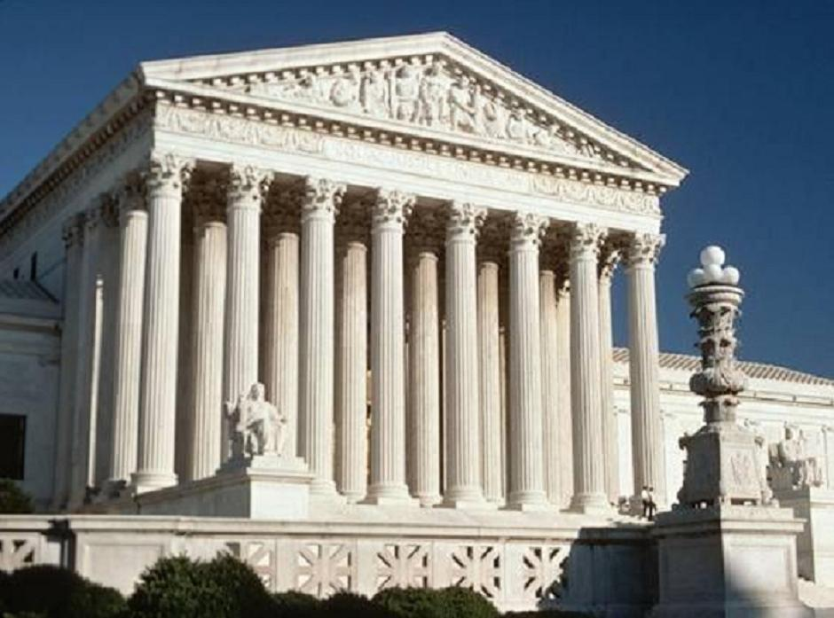
Judicial “checks”
Judicial on legislative – Chief Justice of the Supreme Court presides over impeachment trials for the president, interpret and apply laws; and
Judicial on executive – judges not subject to removal by president, interpret and apply laws.

Slide 33
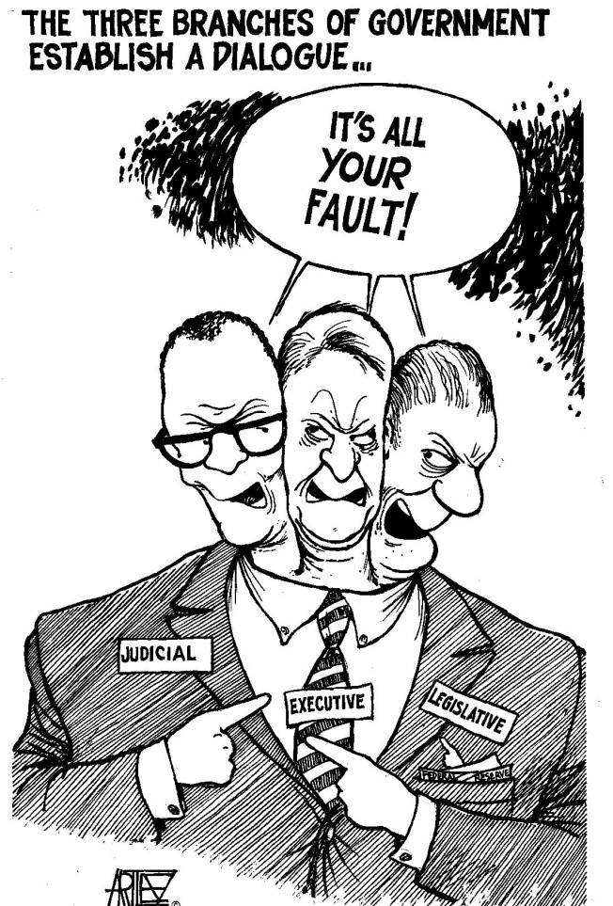
Interactions
The interaction among the three branches of government is impacted by factors such as:
Interest group involvement (e.g., proposing legislation, advocating rules, filing briefs)
Political party control of the executive and legislative branches
Amount of public interest and nature of media coverage/commentary; and
Informal relationships among the members of each branch.

